Slide 1
Intro: Mobile Platforms
Programming Languages
&
Location Aware Apps
Subject Name: Platform Based Development
Subject Code: PBDE401 | PBDV301
Lecturer Name : Freedom Khubisa
Department : Information Technology

Slide 2
Outline of the lesson
Objectives
Define mobile apps and explain their purpose on smartphones and tablets.
Identify different types of mobile apps: native, cross-platform, and hybrid.
Describe how mobile apps interact with device hardware and APIs.
Explain the benefits of mobile apps for users and businesses

Slide 3

Mobile Platforms
Operating Systems
Development Frameworks
Programming Languages
APIs
Tools

Slide 4
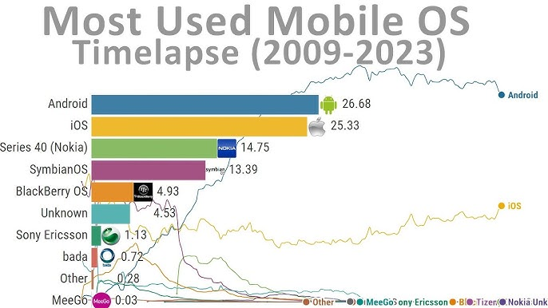
Widely Used Mobile Platforms (Operating Systems)
Android
iOS
HarmonyOs
KaiOS

Slide 5
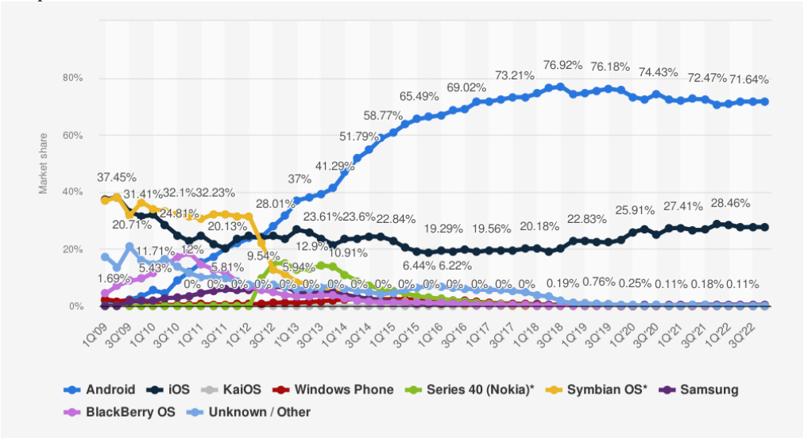
Mobile Operating System Market Share Analysis

Slide 6
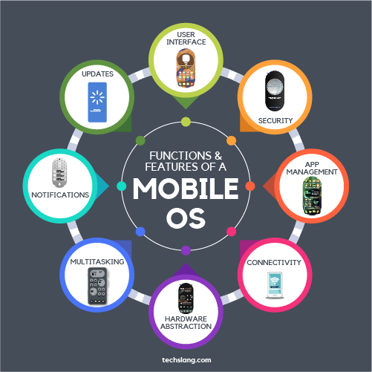
Mobile Platform Core Functions
Process Management
Memory Management
Device & Hardware Management
Security Management
User Interface (UI) Management
Networking & Communication
Application Lifecycle Management
Power & Battery Management

Slide 7

Mobile Applications
Mobile applications, or "apps," are software programs designed to run on mobile devices such as smartphones and tablets, offering a wide range of functionalities from communication and entertainment to productivity and business tools:
Social Media (e.g. Instagram, Facebook, Twitter (X), TikTok, Snapchat )
Messaging (e.g. WhatsApp, Telegram, Messenger)
Entertainment (e.g. Spotify, Netflix, YouTube)
Productivity (e.g. Microsoft Teams, Google Docs, Evernote, Zoom)

Slide 8
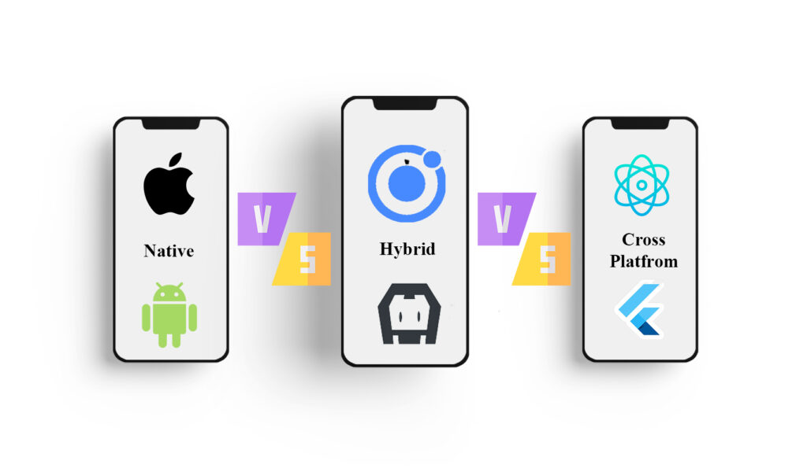
Strategies of Mobile Application Dev

Slide 9
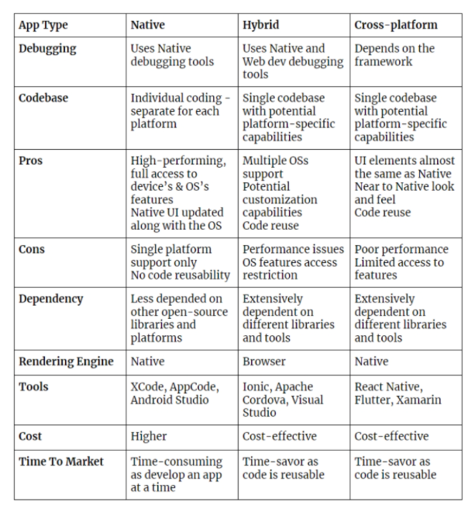
Native vs Hybrid vs Cross Platform Apps

Slide 10
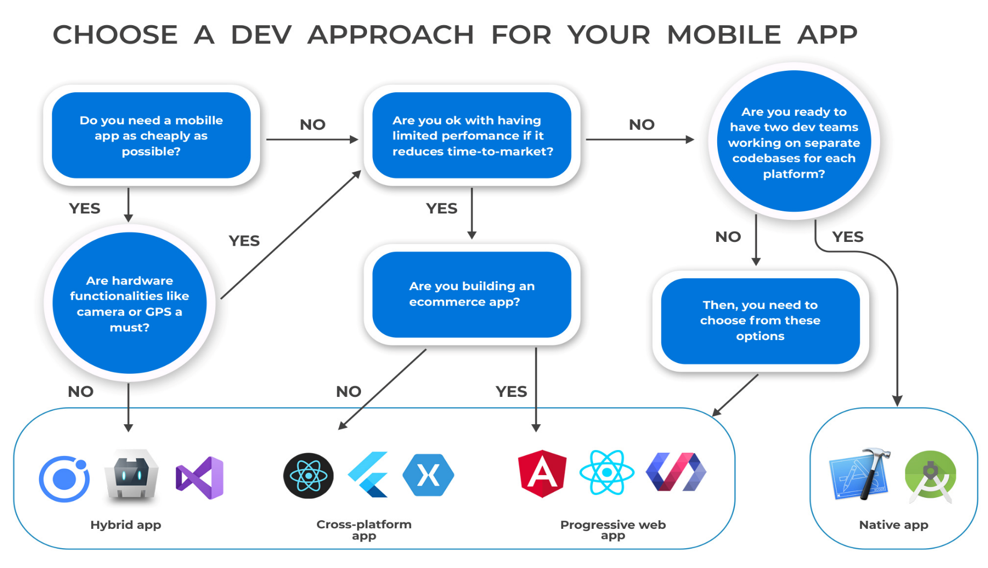
Framework: Dev Approach

Slide 11


Mobile Programming Languages

Slide 12
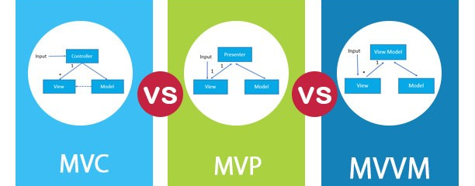
Mobile Platform Architectures

Slide 13
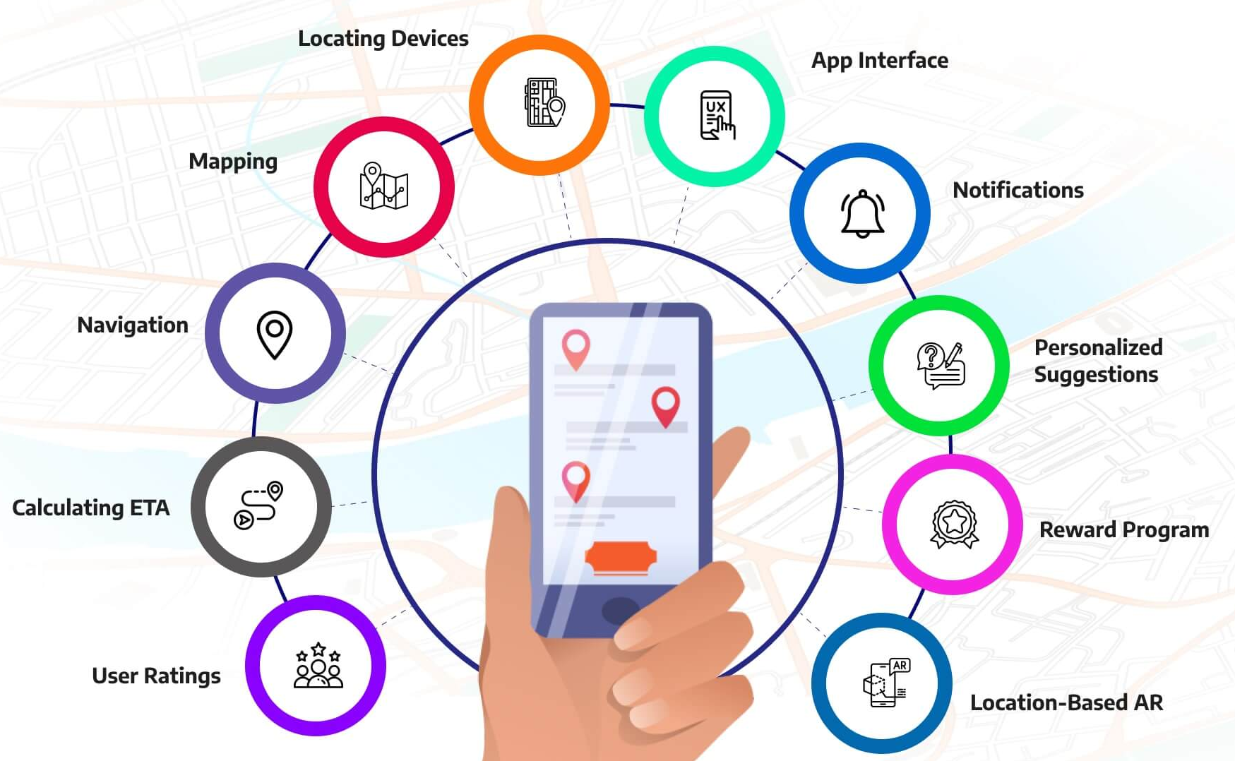
Location Aware Applications
Location-aware apps use geographic data to provide services based on the user's location.
Technologies used:
  GPS
  Wi-Fi positioning
  Cell tower triangulation

Slide 14
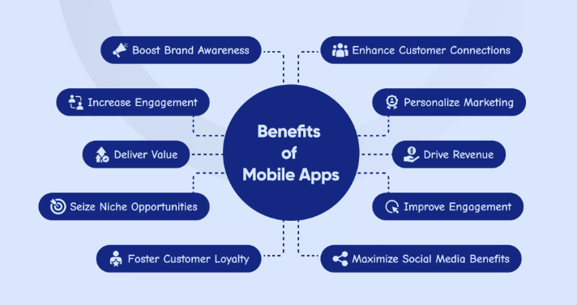
Business Perspective

Slide 15

Factors to consider: Mobile App Dev
Parameters for consideration may include:
  Targeted device (OS platform)
  UI and UX
  Device features (Access to native hardware features through APIs)
  Performance
  Easily upgradeable
  Security
  Cost (Cheap development cost?)

